Slide 1
oTree
Filipp Chapkovski
April 3-4, 2017

Slide 2
Link to go now: | http://bit.ly/otree-mainz
Materials and code for this workshop: | https://github.com/chapkovski/mainz
My e-mail: | chapkovski@gmail.com
oTree support group: | https://groups.google.com/forum/#!forum/otree

Slide 3
Outline
April 3, Monday
Session 1 – main oTree components (views, models, templates)
Session 2 – multi player, multi-round games in oTree
April 4, Tuesday
Session 3 – multi player, multi-round games in oTree
Session 4 – Advanced oTree: channels, mTurk. Discussion of participants’ projects

Slide 4
Python in 5 minutes
Indent to begin the block
Comment: #
Lists: a = [1, 2, 3,]
Call the item from the list: a[0], a[1:2]
Dictionary: {key: value}. Such as b = {‘name’: Filipp, ‘city’: Zurich}
Call the item from the dictionary: b[‘name’]. Adding: the same
Functions are declared with the "def" keyword.
List comprehension: [i for i in a if i % 2 == 0]

Slide 5
MVC
Models
Views
Controller
Django
oTree is built upon it

Slide 6
Creating first project and first app
virtualenv mainzwp
cd mainzwp
otree startproject mainz
otree startapp guessquiz
settings.py:
SESSION_CONFIGS = [
{
'name': 'guess',
'display_name': 'Guess game',
'num_demo_participants': 1,
'app_sequence': ['guess'],
},

Slide 7
Guess game: planning
A player has an endowment.
Random number is generated within certain limits
A player has to guess. The closer is the guyess to a real number the larger is the profit.
Two fields: what is guessed, and a player’s decision
Three screens:
Intro: instructions
Decision with instructions
Results

Slide 8
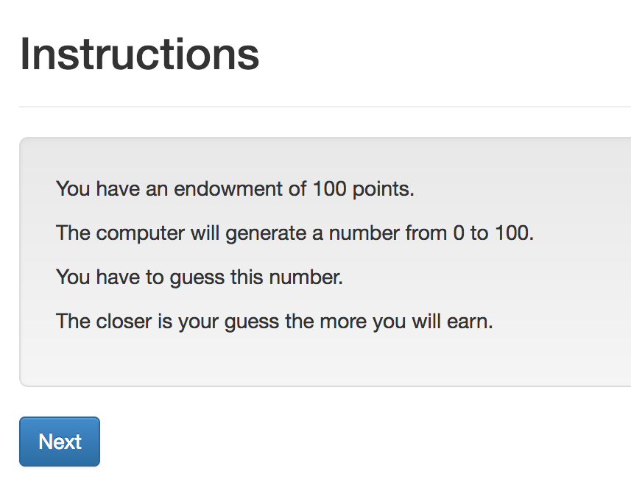
Guess game: screen 1

Slide 9
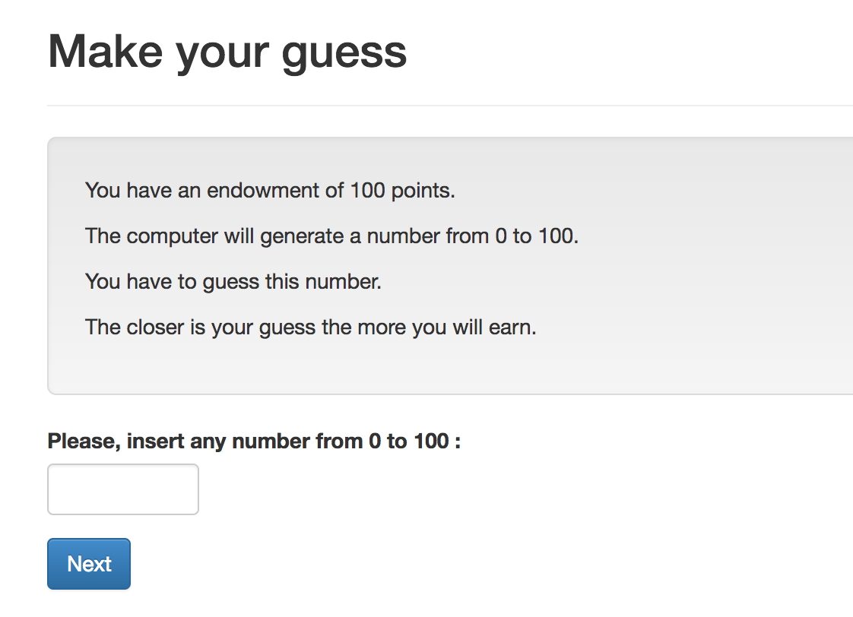
Guess game: screen 2

Slide 10
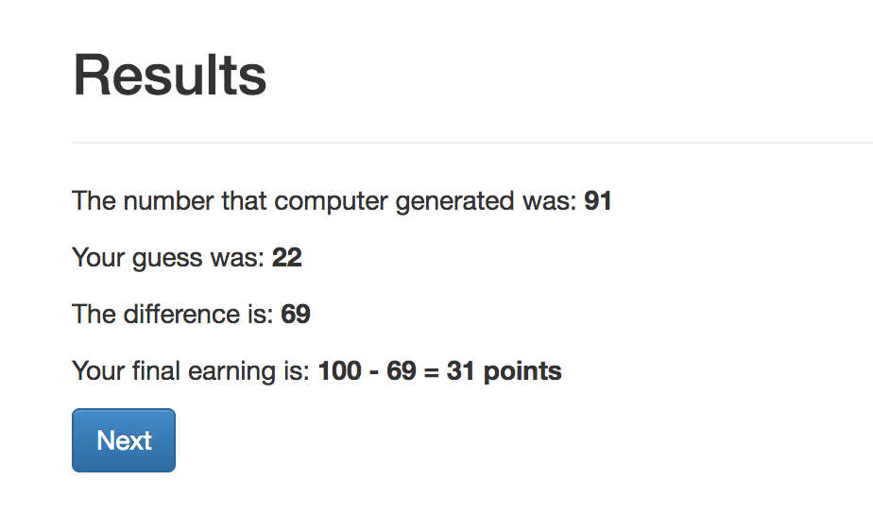
Guess game: screen 3

Slide 11
Guess game - Models
Creating new fields:
Field_Name = models.IntegerField()
Options:
Field_Name = models.IntegerField(
max=…,
min=…,
verbose_name=…,)

Slide 12
Guess game: Models. Result:
class Player(BasePlayer):
toguess = models.IntegerField(min=Constants.minguess,
max=Constants.maxguess,
doc='random number for a player to guess')
guess = models.IntegerField(min=Constants.minguess,
max=Constants.maxguess,
verbose_name="Please, insert \
any number from {} to \
{}".format(Constants.minguess,
Constants.maxguess,),
doc='guess of the player')

Slide 13
Guess game: Views
Creating new page
Class NameOfThePage(Page):
pass
Page_sequence
Page_sequence = [NameOfThePage]
By default name of the template should correspond to the page name!

Slide 14
Guess game: Views. Built-in functions
Built-in functions of pages:
”Normal” page:
def is_displayed(self):
return (True/False)
def vars_for_template(self):
return {‘var’: var}
def before_next_page(self):
…

Slide 15
Guess game - Templates
{% extends "global/Page.html" %}
{% load staticfiles otree_tags %}
{% block title %} YOUR TITLE HERE {% endblock %}
{% block content %}
YOUR CONTENT HERE
{% endblock %}

Slide 16
Guess game - Templates
to include another file (for example instructions):
{% include ‘path_to_file/name_of_file.html %}
to make ‘Next button’:
{% next_button %}

Slide 17
Guess game: Views. Intro

Slide 18
Intro: How to do it?
Models.py: Constants:
endowment
minguess
maxguess
Intro.html:
in {% block content %}:
to refer to the constant: {{Constants.endowment}}.
Case sensitive!
No calculations! It is not Python!

Slide 19
Intro: Results:
{% extends "global/Page.html" %}
{% load staticfiles otree_tags %}
{% block title %}Instructions{% endblock %}
{% block content %}
{% include 'guess/instructions.html' %}
{% next_button %}
{% endblock %}
WHY?

Slide 20
Views.Decision

Slide 21
Views.Decision. How to do it?
Referring to models. field in views.py:
class Decision(Page):
form_model = models.Player
form_fields = ['guess']
referring to a field in a template:
{% formfield player.guess %} OR {{form}}
Generating random number:
class Intro(Page):
def before_next_page(self):
toguess = random.randint(Constants.minguess, Constants.maxguess)
self.player.toguess = toguess

Slide 22
Views.Resuts

Slide 23
Views.Resuts. How to do it?
in views.py: Decision page:
class Decision(Page):
...
def before_next_page(self):
self.player.set_payoff()
in models.py :
class Player(BasePlayer):
…
def set_payoff(self):
self.diff = abs(self.guess - self.toguess)
self.payoff = Constants.endowment - self.diff

Slide 24
Running the app
otree resetdb
otree runserver
go to: http://127.0.0.1:8000

Slide 25
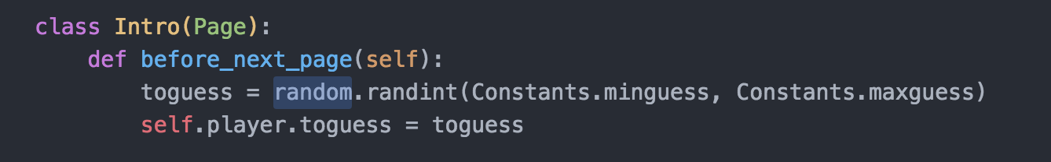
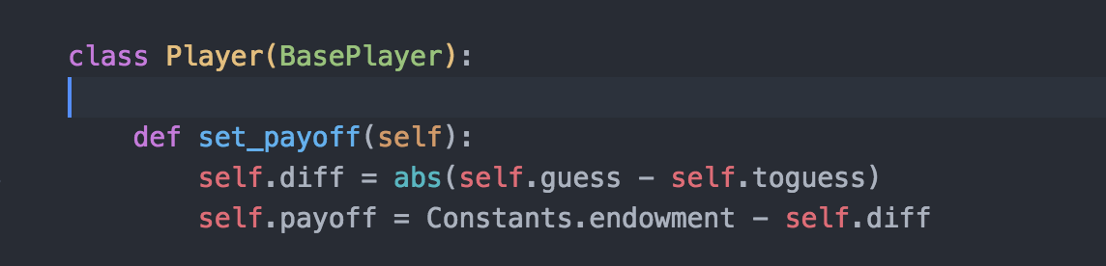
what is self?
SELF refers to the object of the class where we currently work in.

Slide 26
Hierarchy of objects
Session
Subsession
Group
Player - Participant
Page

Slide 27
What runs when
Class definition
Subsession: def before_session starts(self)
Page: is_displayed
Page: vars_for_template
Page: before_next_page
WaitPage: is_displayed
WaitPage: after_all_players_arrive

Slide 28
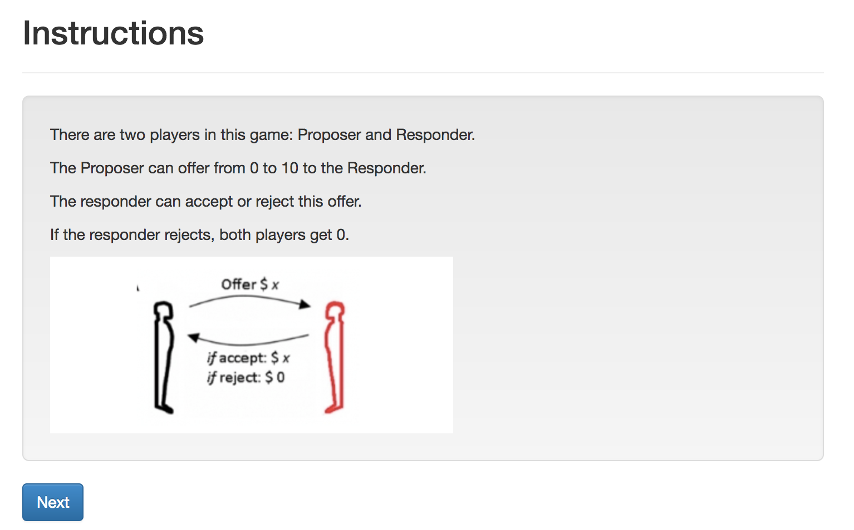
Ultimatum. Screen 1. Intro

Slide 29
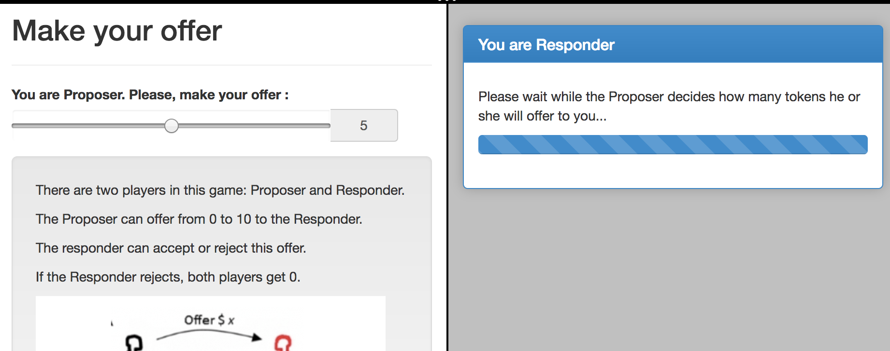
Ultimatum. Screen 2. Offer

Slide 30
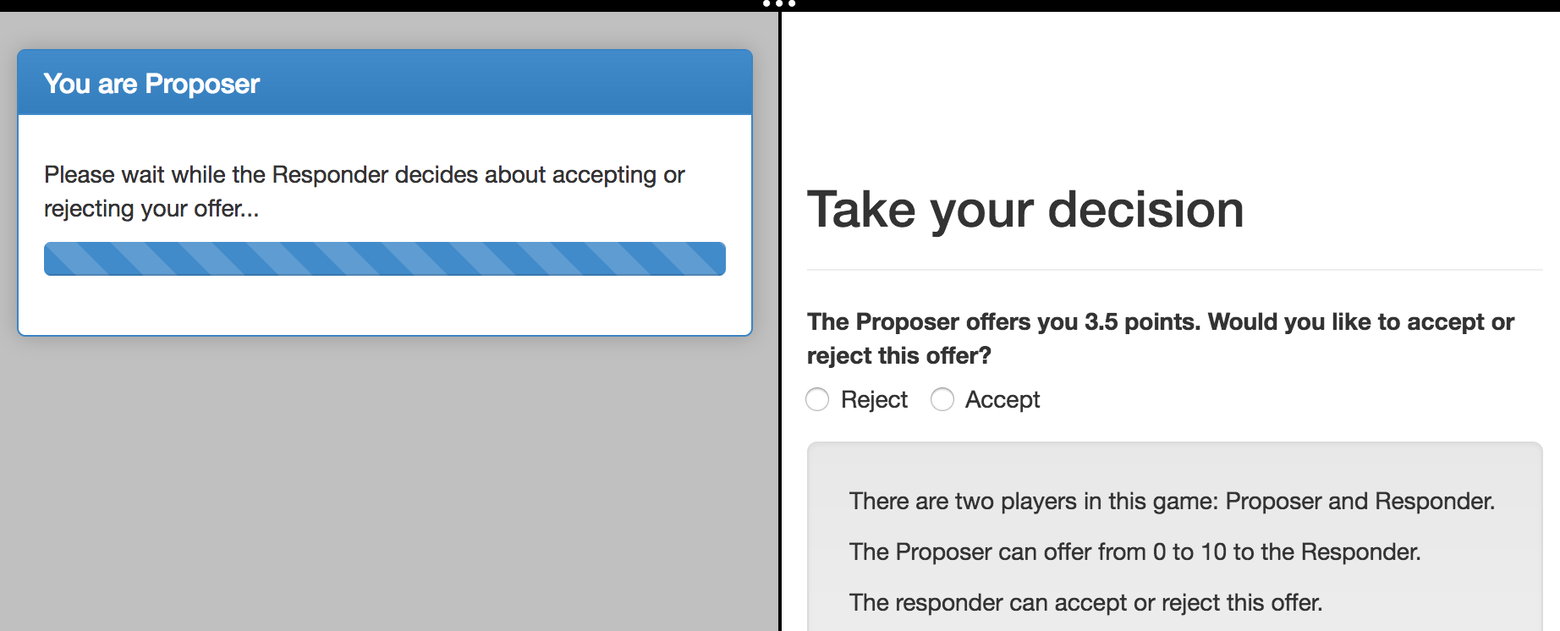
Ultimatum. Screen 3. Accept/Reject

Slide 31
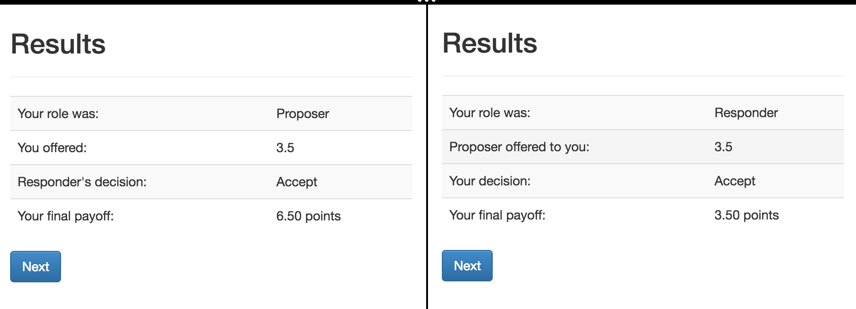
Ultimatum. Screen 4. Results

Slide 32
Ultimatum: some preliminary prep
Let’s run ‘otree startapp ultimatum’
and copy from our guess app: intro, decision, instructions
… rename in intro and decision the % include %:
TO: {% include 'ultimatum/instructions.html' %}
make a copy of decision.html
rename files to: Offer.html, Accept.html

Slide 33
Ultimatum: multi-player game
In models.py: Constants: players_per_group = 2
NB: when there is only one player then players_per_group = None, not 1!
In Player we define function that returns the role
class Player(BasePlayer):
def role(self):
if self.id_in_group == 1:
return 'Proposer'
if self.id_in_group == 2:
return 'Responder'

Slide 34
Ultimatum: planning I
The workflow:
1. Introduction
2. Player 1 decides about an offer, Player 2 waits
3. Player 2 decides whether accepting or not. Player 1 waits.
4. Both see the results.
We need 6 pages. For (2) and (3) we a set of (Page, WaitPage)
Page in (2) will be shown only to Proposer
Page in (3) will be shown only to Responder

Slide 35
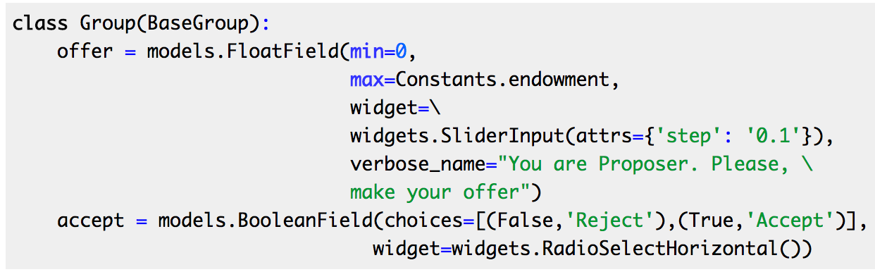
Ultimatum: models.py
Creating new fields in models.py:
We need fields in group, because these fields are the same for both players.
Notes:
class Group(BaseGroup):
offer = models.FloatField(min=0,
max=Constants.endowment,
widget=\
widgets.SliderInput(attrs={'step': '0.1'}),
verbose_name="You are Proposer. Please, \
make your offer")
accept = models.BooleanField(choices=[(False,'Reject'),(True,'Accept')],
widget=widgets.RadioSelectHorizontal())
def set_payoffs(self):
proposer = self.get_player_by_role('Proposer')
responder = self.get_player_by_role('Responder')
proposer.payoff = (Constants.endowment - self.offer) * self.accept
responder.payoff = self.offer * self.accept

Slide 36
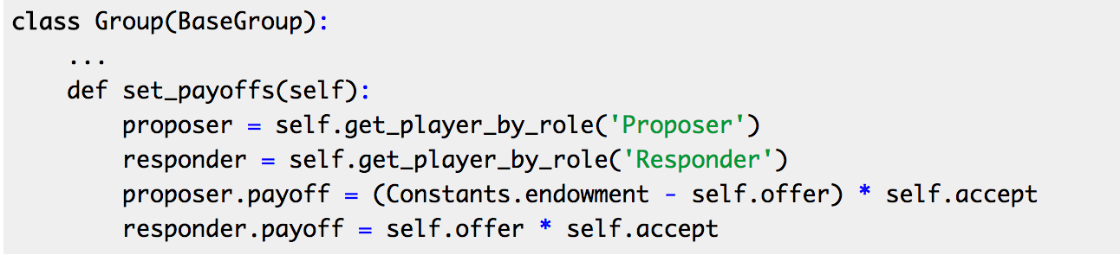
Ultimatum: models.py
Defining the function that will be able to set the payoffs of the players depending on their role in a group:
Notes:
class Group(BaseGroup):
offer = models.FloatField(min=0,
max=Constants.endowment,
widget=\
widgets.SliderInput(attrs={'step': '0.1'}),
verbose_name="You are Proposer. Please, \
make your offer")
accept = models.BooleanField(choices=[(False,'Reject'),(True,'Accept')],
widget=widgets.RadioSelectHorizontal())
def set_payoffs(self):
proposer = self.get_player_by_role('Proposer')
responder = self.get_player_by_role('Responder')
proposer.payoff = (Constants.endowment - self.offer) * self.accept
responder.payoff = self.offer * self.accept

Slide 37
Static files: how insert an image?
Create folder in an app:
…/static/ultimatum
Put your image there
insert in in the beginning of your instructions.html:
{% load staticfiles %}
and in the text:
<img src="{% static "ultimatum/ultimatum.png" %}"/>
Notes:
from otree.api import Currency as c, currency_range
from . import models
from ._builtin import Page, WaitPage
from .models import Constants
class Intro(Page):
pass
class Offer(Page):
form_model = models.Group
form_fields = ['offer']
def is_displayed(self):
return self.player.role() == 'Proposer'
def vars_for_template(self):
...
class OfferWaitPage(WaitPage):
title_text = "You are Responder"
body_text = "Please wait while the Proposer decides how many tokens he \
or she will offer to you..."
class Accept(Page):
form_model = models.Group
form_fields = ['accept']
def is_displayed(self):
return self.player.role() == 'Responder'
def vars_for_template(self):
return {'offer_text': "The Proposer offers you {} points. Would you like \
to accept or reject this offer?".format(self.group.offer)}
class ResultsWaitPage(WaitPage):
title_text = "You are Proposer"
body_text = "Please wait while the Responder decides about accepting \
or rejecting your offer..."
def after_all_players_arrive(self):
self.group.set_payoffs()
class Results(Page):
def vars_for_template(self):
return {'accept': 'Accept' if self.group.accept else 'Reject'}
page_sequence = [
Intro,
Offer,
OfferWaitPage,
Accept,
ResultsWaitPage,
Results
]

Slide 38
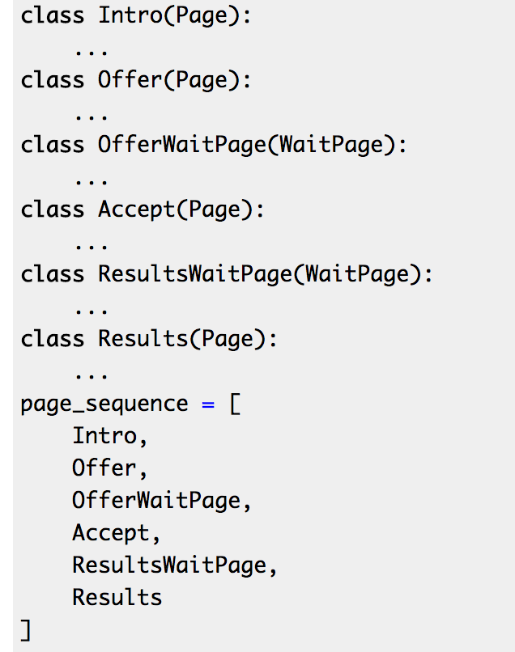
Ultimatum: views.py
class Offer(Page):
form_model = models.Group
form_fields = ['offer']
def is_displayed(self):
return self.player.role() == 'Proposer'
class OfferWaitPage(WaitPage):
title_text = "You are Responder"
body_text = "Please wait while the Proposer decides how many tokens he \
or she will offer to you...”
def is_displayed(self):
return self.player.role() == 'Responder'
Notes:
from otree.api import Currency as c, currency_range
from . import models
from ._builtin import Page, WaitPage
from .models import Constants
class Intro(Page):
pass
class Offer(Page):
form_model = models.Group
form_fields = ['offer']
def is_displayed(self):
return self.player.role() == 'Proposer'
def vars_for_template(self):
...
class OfferWaitPage(WaitPage):
title_text = "You are Responder"
body_text = "Please wait while the Proposer decides how many tokens he \
or she will offer to you..."
class Accept(Page):
form_model = models.Group
form_fields = ['accept']
def is_displayed(self):
return self.player.role() == 'Responder'
def vars_for_template(self):
return {'offer_text': "The Proposer offers you {} points. Would you like \
to accept or reject this offer?".format(self.group.offer)}
class ResultsWaitPage(WaitPage):
title_text = "You are Proposer"
body_text = "Please wait while the Responder decides about accepting \
or rejecting your offer..."
def after_all_players_arrive(self):
self.group.set_payoffs()
class Results(Page):
def vars_for_template(self):
return {'accept': 'Accept' if self.group.accept else 'Reject'}
page_sequence = [
Intro,
Offer,
OfferWaitPage,
Accept,
ResultsWaitPage,
Results
]

Slide 39
Ultimatum: views.py
class Accept(Page):
form_model = models.Group
form_fields = ['accept']
def is_displayed(self):
return self.player.role() == 'Responder'
def vars_for_template(self):
return {'offer_text': "The Proposer offers you {} points. Would you like \
to accept or reject this offer?".format(self.group.offer)}
class ResultsWaitPage(WaitPage):
title_text = "You are Proposer"
body_text = "Please wait while the Responder decides about accepting \
or rejecting your offer..."
def after_all_players_arrive(self):
self.group.set_payoffs()
Notes:
from otree.api import Currency as c, currency_range
from . import models
from ._builtin import Page, WaitPage
from .models import Constants
class Intro(Page):
pass
class Offer(Page):
form_model = models.Group
form_fields = ['offer']
def is_displayed(self):
return self.player.role() == 'Proposer'
def vars_for_template(self):
...
class OfferWaitPage(WaitPage):
title_text = "You are Responder"
body_text = "Please wait while the Proposer decides how many tokens he \
or she will offer to you..."
class Accept(Page):
form_model = models.Group
form_fields = ['accept']
def is_displayed(self):
return self.player.role() == 'Responder'
def vars_for_template(self):
return {'offer_text': "The Proposer offers you {} points. Would you like \
to accept or reject this offer?".format(self.group.offer)}
class ResultsWaitPage(WaitPage):
title_text = "You are Proposer"
body_text = "Please wait while the Responder decides about accepting \
or rejecting your offer..."
def after_all_players_arrive(self):
self.group.set_payoffs()
class Results(Page):
def vars_for_template(self):
return {'accept': 'Accept' if self.group.accept else 'Reject'}
page_sequence = [
Intro,
Offer,
OfferWaitPage,
Accept,
ResultsWaitPage,
Results
]

Slide 40
Ultimatum: dynamic label in Accept
{% block content %}
{% formfield group.accept with label=offer_text %}
{% include 'ultimatum/instructions.html' %}
<br>
{% next_button %}
{% endblock %}

Slide 41
Ultimatum. Results
<table class="table table-striped table-hover">
<tr>
<td>Your role was:</td>
<td>{{player.role}}</td>
</tr>
{% if player.role == "Proposer" %}
<tr>
<td>You offered:</td>
<td>{{group.offer}}</td>
</tr>
<tr>
<td>Responder's decision:</td>
<td>{{accept}}</td>
</tr>
{% else %}
<tr>
<td>Proposer offered to you:</td>
<td>{{group.offer}}</td>
</tr>
<tr>
<td>Your decision:</td>
<td>{{accept}}</td>
</tr>
{% endif %}
<tr>
<td>Your final payoff:</td>
<td>{{player.payoff}}</td>
</tr>
</table>
Notes:
{% extends "global/Page.html" %}
{% load staticfiles otree_tags %}
{% block title %}
Results
{% endblock %}
{% block content %}
<table class="table table-striped table-hover">
<tr>
<td>Your role was:</td>
<td>{{player.role}}</td>
</tr>
{% if player.role == "Proposer" %}
<tr>
<td>You offered:</td>
<td>{{group.offer}}</td>
</tr>
<tr>
<td>Responder's decision:</td>
<td>{{accept}}</td>
</tr>
{% else %}
<tr>
<td>Proposer offered to you:</td>
<td>{{group.offer}}</td>
</tr>
<tr>
<td>Your decision:</td>
<td>{{accept}}</td>
</tr>
{% endif %}
<tr>
<td>Your final payoff:</td>
<td>{{player.payoff}}</td>
</tr>
</table>
{% next_button %}
{% endblock %}

Slide 42
Ultimatum. Results
<table class="table table-striped table-hover">
<tr>
<td>Your role was:</td>
<td>{{player.role}}</td>
</tr>
{% if player.role == "Proposer" %}
<tr>
<td>You offered:</td>
<td>{{group.offer}}</td>
</tr>
<tr>
<td>Responder's decision:</td>
<td>{{accept}}</td>
</tr>
{% else %}
<tr>
<td>Proposer offered to you:</td>
<td>{{group.offer}}</td>
</tr>
<tr>
<td>Your decision:</td>
<td>{{accept}}</td>
</tr>
{% endif %}
<tr>
<td>Your final payoff:</td>
<td>{{player.payoff}}</td>
</tr>
</table>
class Results(Page):
def vars_for_template(self):
return {'accept': 'Accept' if self.group.accept else 'Reject'}
in settings.py:
POINTS_DECIMAL_PLACES = 2
Notes:
{% extends "global/Page.html" %}
{% load staticfiles otree_tags %}
{% block title %}
Results
{% endblock %}
{% block content %}
<table class="table table-striped table-hover">
<tr>
<td>Your role was:</td>
<td>{{player.role}}</td>
</tr>
{% if player.role == "Proposer" %}
<tr>
<td>You offered:</td>
<td>{{group.offer}}</td>
</tr>
<tr>
<td>Responder's decision:</td>
<td>{{accept}}</td>
</tr>
{% else %}
<tr>
<td>Proposer offered to you:</td>
<td>{{group.offer}}</td>
</tr>
<tr>
<td>Your decision:</td>
<td>{{accept}}</td>
</tr>
{% endif %}
<tr>
<td>Your final payoff:</td>
<td>{{player.payoff}}</td>
</tr>
</table>
{% next_button %}
{% endblock %}

Slide 43
Github and heroku
WINDOWS
git config --global credential.helper wincred
macOS
git credential-osxkeychain
git config --global user.name "YOUR NAME"
Tell Git the email address that will be associated with your Git commits. The email you specify should be the same one found in your email settings.
Install Heroku toolbelt

